Slide 1
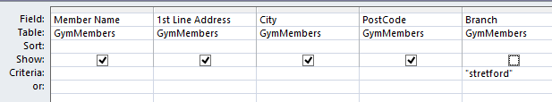
Prepare a mail merge letter using the file Gym letter.doc as your Master and the GymMembers.CSV as the source data.
Import the CSV file into a database application
Run a query to find all customers going to the Stretford branch. Show the following fields:
Member Name
1st line Address
City
Post Code
Insert the relevant address fields
Insert a date field
Add your name at the bottom at the letter

Slide 2
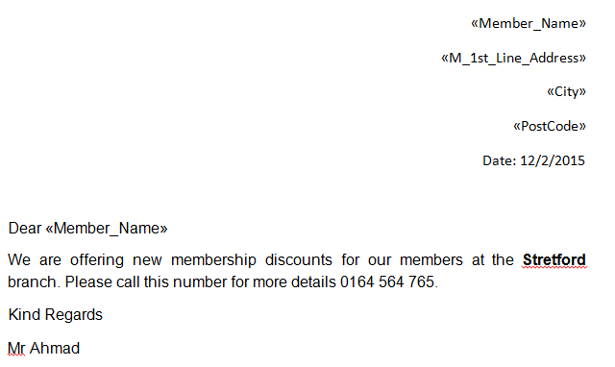
Only merge the letter to the customers using the query.
Insert the relevant address fields
Insert a date field
Add your name at the bottom at the letter
Customer’s Address
Customer Name
Date
Your Name

Slide 3
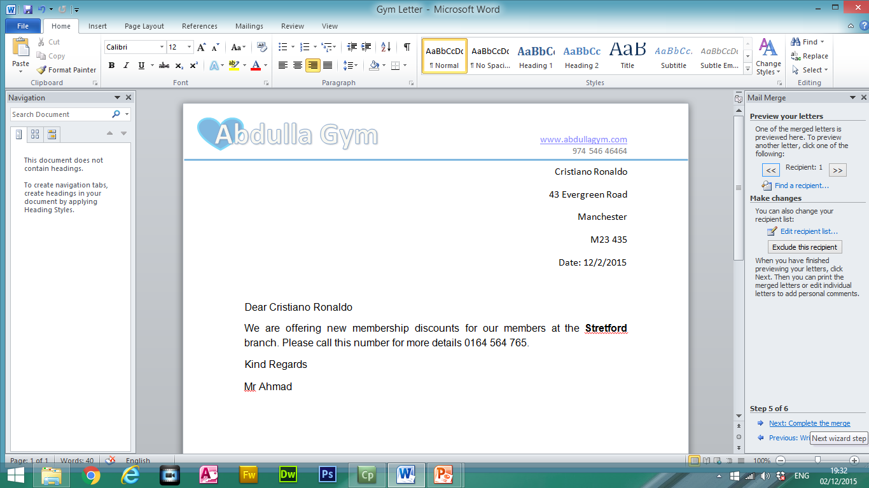
Add a minimum of three features to the mail merge master document to suit a professional letter:
Features could include:
Logo
Company Name
Contact Details/Email/Fax
Web Address
Address
Shapes
Lines
Master Document

Slide 4
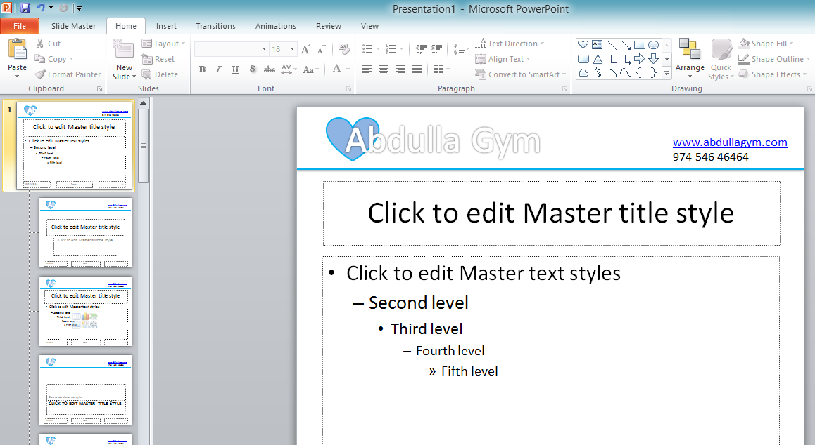
Create a slide master using the features from the Master Mail Merge Letter. The slide master will be applied to all slides.
Letter Head
Slide Master

